Slide 1
Low-cost smart footwear for remote gait monitoring of incomplete spinal cord injured patients
GUIDED BY
DR. MUTHULAKSHMI S, ASSOCIATE PROFESSOR GRADE 2

Slide 2
Team Members
S BHARATH -20BEC1152
TULASI VAMSI KRISHNA -20BEC1110
KOLA SAI KISHORE -20BEC1224

Slide 3
Agenda
Introduction
Prominence of Gait
Parameters
Process Flow
Steps involved
ZUPT
Formulas
Components
DMP
Block Diagram
Hardware
Setup
Data Visualization
Data Acquisition

Slide 4
Introduction
Spinal cord injury (SCI) can cause various gait impairments, making it difficult to walk. To assess these impairments and guide rehabilitation, researchers developed a sensor-based gait analysis using body-mounted inertial sensors.
Traditional gait analysis is often expensive, complex, and restricted to lab settings. This new approach is portable, affordable, and can be used in clinics or even homes. It uses an adaptable algorithm to detect gait events such as heel strike and toe-off, even for diverse gait patterns and walking speeds.
This sensor-based analysis was validated against the gold standard gait analysis and showed promising results. It has the potential to be integrated into daily clinical routines, allowing for personalized rehabilitation programs and improved care for people with SCI.

Slide 5
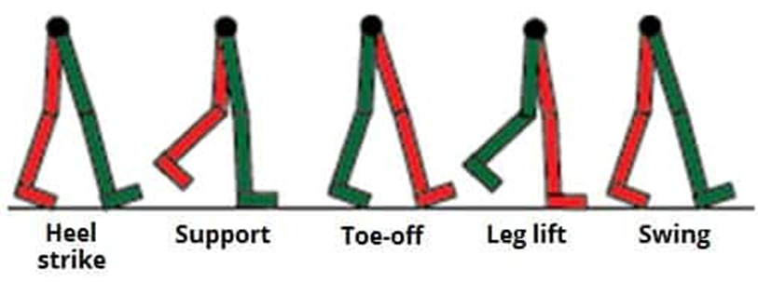
Prominence of Gait
Gait analysis with body-mounted sensors is a transformative tool in rehabilitation, offering real-time insights into individuals' walking patterns. These sensors provide therapists with valuable data to craft personalized recovery programs for patients recuperating from injuries or neurological conditions. By precisely monitoring gait dynamics, healthcare professionals can optimize rehabilitation strategies, ensuring tailored interventions that promote effective recovery.

Slide 6



Parameters
GAIT SPEED:
Gait speed is the time one takes to walk a specified distance on level surfaces over a short distance.
CADENCE:
Cadence is a measure of speed calculated as the total number of full cycles (of both foot strike) taken within a given period of time. Stride length:
Stride length is the linear distance covered when you take two steps, one with each foot. stride width:
Stride width is the lateral distance covered when you take two steps, one with each foot.

Slide 7
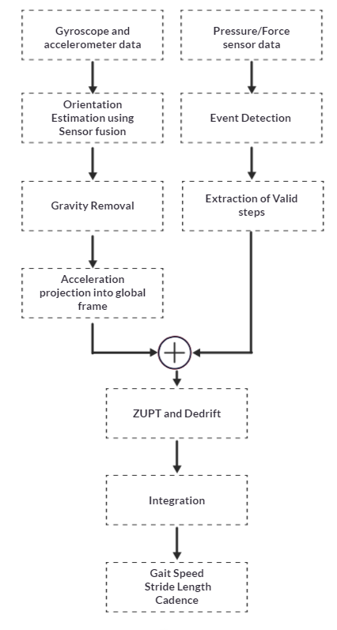
Process Flow

Slide 8
Steps Involved
Defining a starting and ending point of each stride cycle.
Determining the orientation of the inertial sensor with respect to the global coordinate system.
Projecting the gravity component into the sensor coordinate system based on the instantaneous orientation of the inertial sensor and remove the acceleration due to gravity from the sensor acceleration.
Project the gravity free acceleration into the global coordinate system based on the instantaneous orientation of the inertial sensor.
Integrating the acceleration in the global coordinate system from the starting point to obtain instantaneous sensor velocity and the associated stride length.

Slide 9
ZUPT
ZUPT stands for Zero-Velocity Update Technique.
It's a crucial step in processing data from accelerometers used in gait analysis.
Accelerometers measure acceleration, but they can drift over time, accumulating errors.
ZUPT utilizes the fact that during specific gait phases (mid-stance), the foot has minimal or zero velocity.
By assuming zero velocity during these mid-stance periods, ZUPT can effectively reset the accumulated drift in the accelerometer data.
This ensures that the data reflects the true accelerations experienced by the foot during gait, leading to more reliable and accurate analysis.

Slide 10
Formulas
•Stride length = distance in Frontal axis during a stride = dy(n-1) + 0.25*(abs(ay (n))+abs(ay (n-1)))*t*t + abs(vy(n-1))*t
•Gait Speed = Average of all the instantaneous velocities magnitude during a stride
•Cadence = 60*gaitspeed/stridelength*2
•Stride width = distance in sagittal axis during a stride = dx(n-1) + 0.25*(abs(ax(n))+abs(ax (n-1)))*t*t + abs(vx(n-1))*t

Slide 11

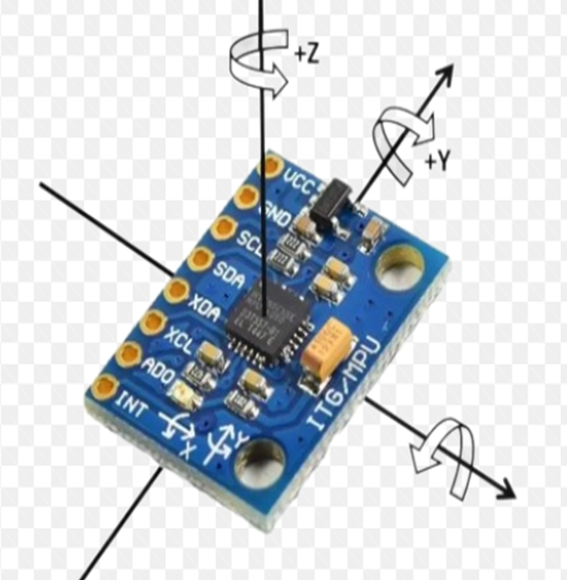
MPU6050
MPU6050 sensor module is complete 6-axis Motion Tracking Device.
It combines 3-axis Gyroscope, 3-axis Accelerometer and Digital Motion Processor all in small package.

Slide 12
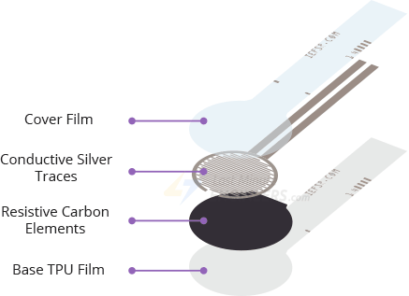
Pressure sensor
The Pressure sensor is a force sensitive resistor whose resistance varies in response to pressure applied to the sensing area.
This sensor is placed in the heel region of the shoe under the sole to detect the starting and ending points of the gait cycle.

Slide 13
DMP and Its Working
DMP Overview:
The Digital Motion Processor (DMP) is a feature embedded within the MPU6050 sensor, designed to offload complex motion processing tasks from the main microcontroller or CPU.
It enhances the sensor's capabilities by providing built-in algorithms for motion processing, such as orientation estimation and gesture recognition.
Orientation Estimation:
DMP utilizes data from the accelerometer and gyroscope sensors to estimate the orientation (pitch, roll, and yaw) of the device in 3D space.
By combining accelerometer and gyroscope measurements, DMP can accurately track the device's orientation over time, even in dynamic environments

Slide 14
DMP and Its Working
Algorithm Integration:
The DMP integrates sensor fusion algorithms, such as Kalman filters or complementary filters, to combine data from multiple sensors and improve orientation estimation accuracy.
It handles sensor calibration and fusion internally, providing developers with orientation data without requiring complex algorithms to be implemented on the main CPU.
Benefits:
Improved performance: Offloading motion processing tasks to the DMP reduces the computational burden on the main microcontroller, allowing for more efficient operation of the system.
Real-time orientation data: DMP provides real-time updates of the device's orientation, enabling applications such as gaming, virtual reality, and inertial navigation systems.

Slide 15
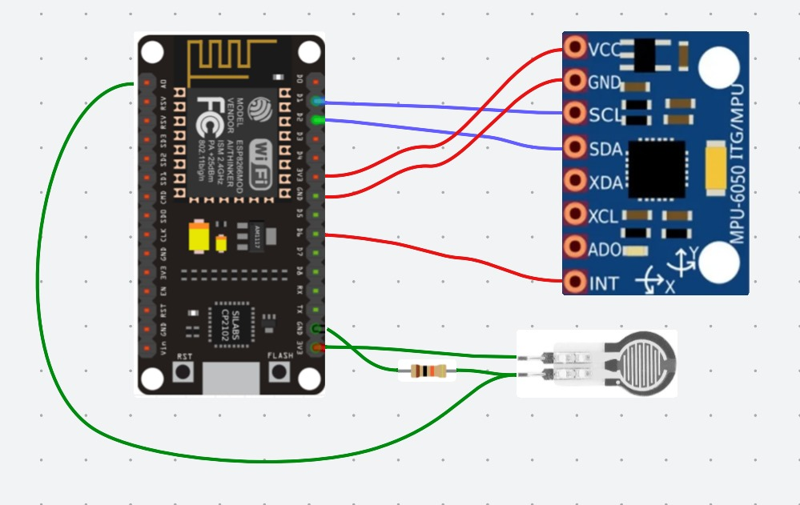
Block diagram

Slide 16
Circuit Connections
MPU6050 Sensor Connection:
Connect the VCC pin of the MPU6050 to the 3.3V power source.
Connect the GND pin to the ground (GND) of the ESP8266.
Connect the INT pin to the D6 of ESP8266
Establish communication between the MPU6050 and the ESP8266 using I2C communication protocol (SCL and SDA pins).
Pressure Sensor Connection:
Connect the power (VCC) pin of the pressure sensor to the respective power source.
Connect the ground (GND) pin of the pressure sensor to the Analog read pin and ground source with a 10k resistor.

Slide 17
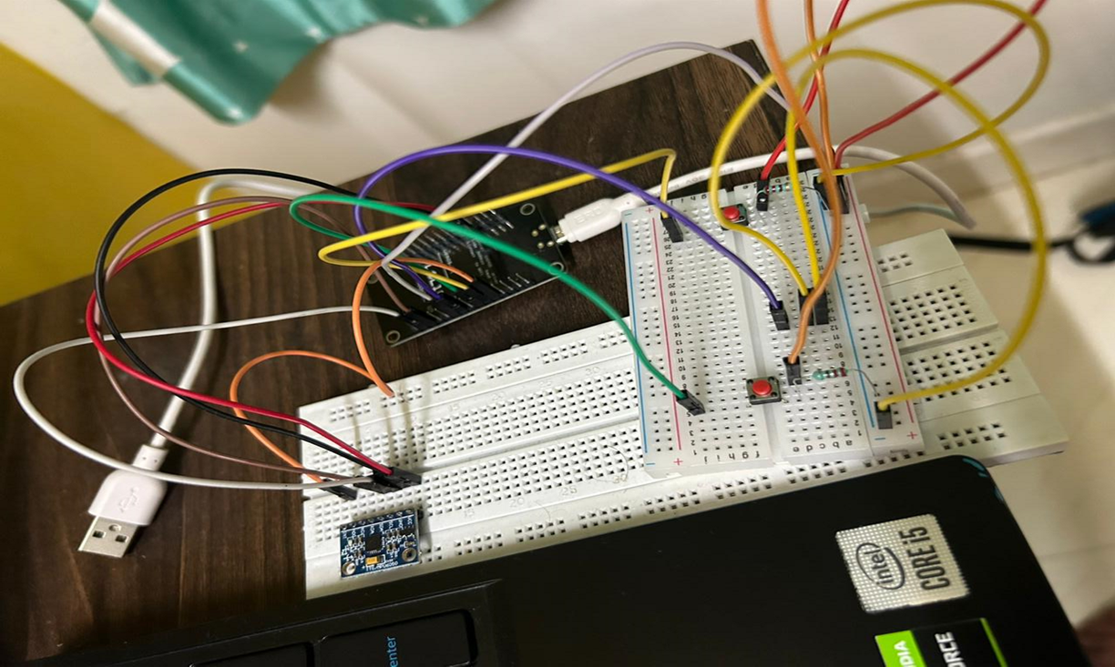
Hardware

Slide 18
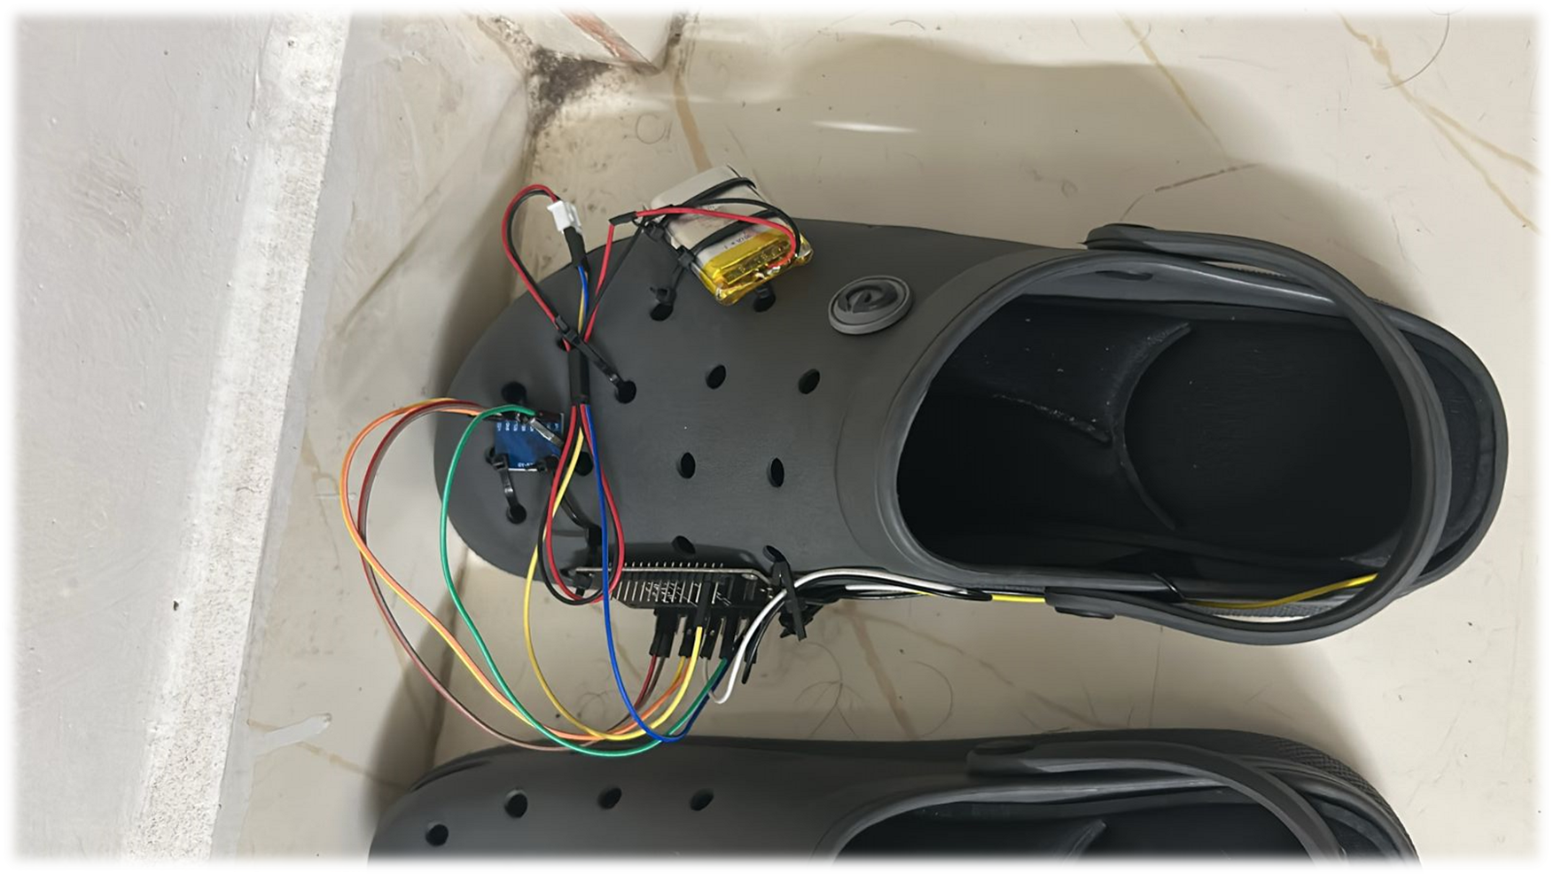
Hardware

Slide 19
Smart Shoe System Setup and Wireless Data Collection
The smart shoe system integrates seamlessly within a regular shoe.
MPU6050 IMU sensors with DMP are strategically placed for accurate orientation estimation.
Pressure sensors are embedded in the sole to precisely detect gait events (heel strikes).
The system transmits data wirelessly via WiFi for real-time analysis.

Slide 20

Demo video

Slide 21
Presentation of the data in a cloud platform

Slide 22
Data collected from the smart shoe is transmitted to Thingspeak. The platform offers user-friendly dashboards for therapists to visualize key gait parameters.
Parameters like stride length, gait speed, cadence data are displayed.
Therapists can track progress over time and identify areas for improvement in rehabilitation plans.

Slide 23
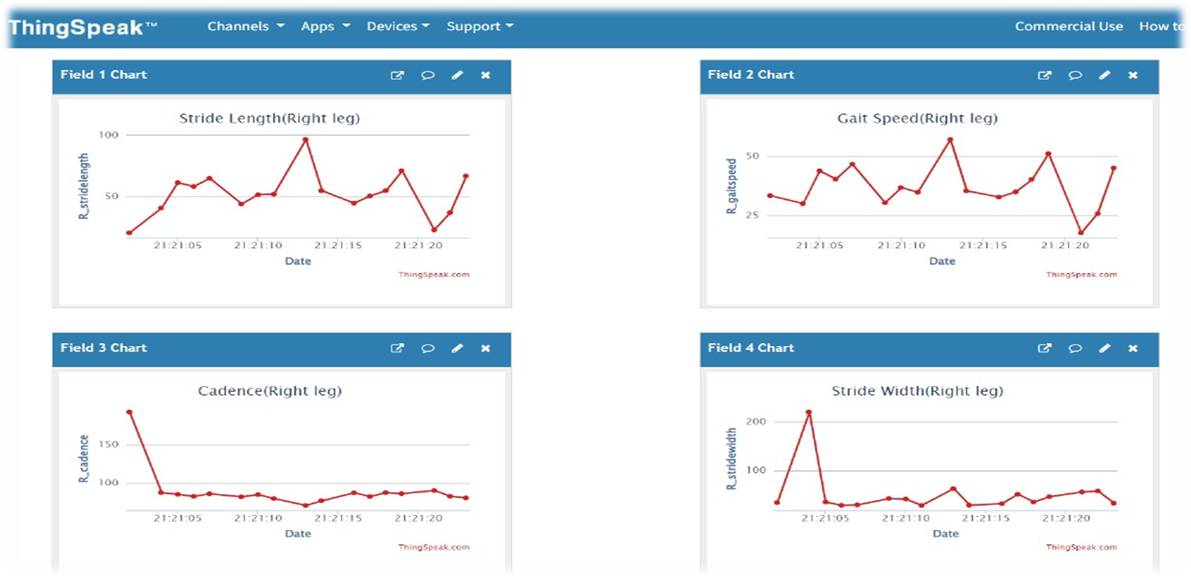

Slide 24
Data Acquisition
A diverse age group of three participants were chosen for the study.
Participants chosen are of varying heights and weights to ensure a representative sample.
Data collection was conducted in controlled, everyday walking environments.
This approach aimed to capture real-world gait patterns during typical walking activities.

Slide 25
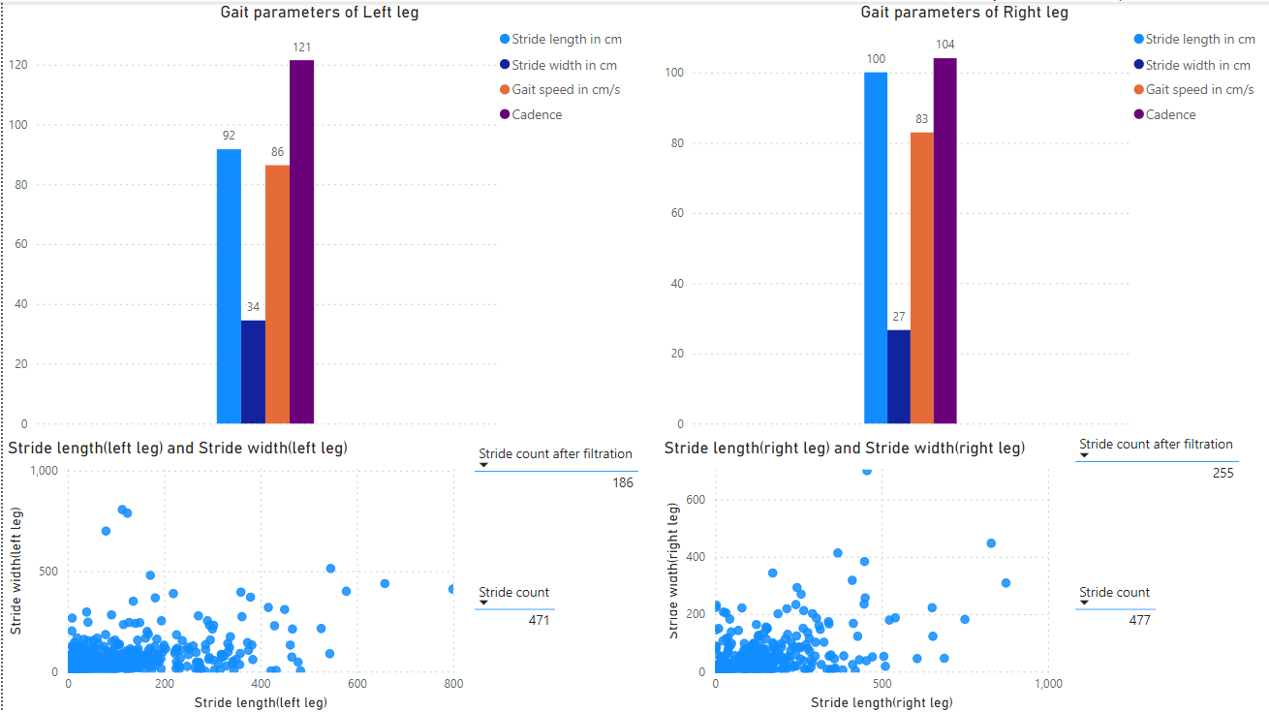
Subject 1

Slide 26
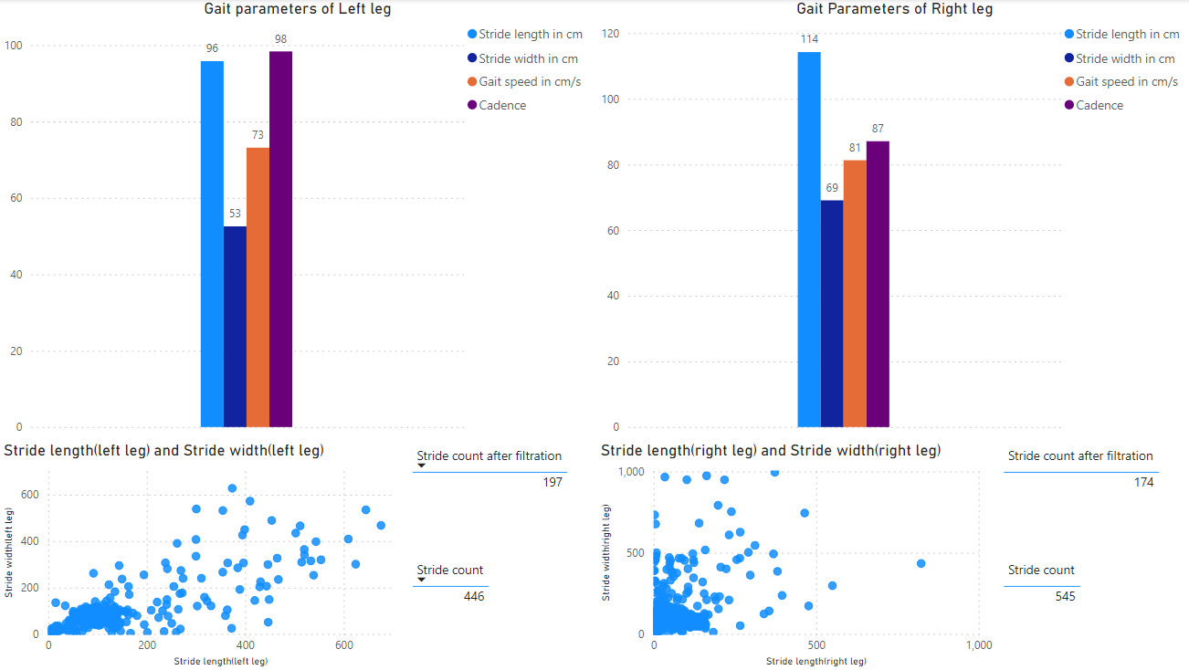
Subject 2

Slide 27
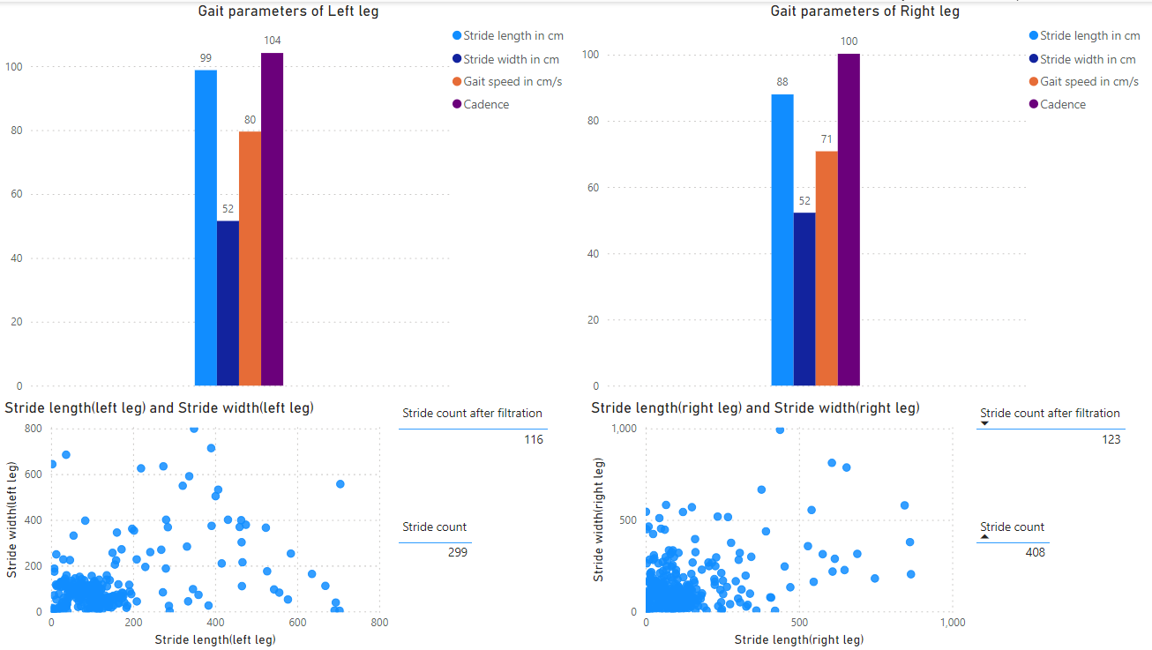
Subject 3

Slide 28
Gait analysis
Parameter | Subject 1 | Subject 2 | Subject 3
Stride length (Left Leg) | 91.71±34.04 | 95.82±26.79 | 98.77±32.04
Stride Width (Left Leg) | 34.49±18.49 | 52.55±14.38 | 51.56±23.67
Gait speed (Left Leg) | 86.38±35.33 | 73.15±20.79 | 79.53±23.32
Cadence (Left Leg) | 121.49±45.31 | 98.36±36.98 | 104.14±38.92
Stride length (Right Leg) | 100.08±29.69 | 114.23±28.32 | 87.98±30.79
Stride Width (Right Leg) | 26.65±16.65 | 69.07±15.96 | 52.24±22.21
Gait speed (Right Leg) | 82.96±33.14 | 81.27±22.45 | 70.80±24.34
Cadence (Right Leg) | 104.09±44.01 | 87.06±20.85 | 100.26±30.73

Slide 29
THANK YOU

